Slide 2
BSeR Project Scope

Slide 4
Service Provider Referral

Slide 5
Service Outcome Reporting

Slide 6
BSeR Project Activity
Requirements Gathering and Domain Analysis
Specification Development and Ballot Submission
Specification Ballot Review, and Prototype Development
Ballot Reconciliation and Prototype Connect-a-thon
Specification Approval and Trial Use

Slide 7
Common, Transaction, and Program Specific Data Items

Slide 8
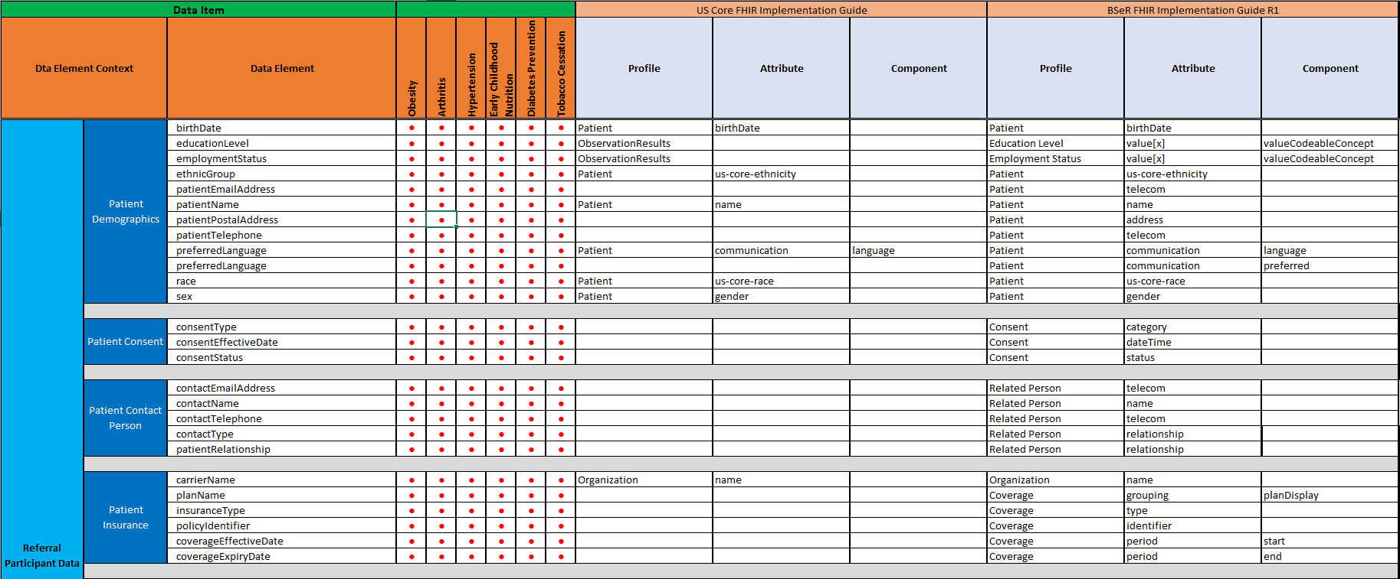
Common Transaction Participant Data Items

Slide 9
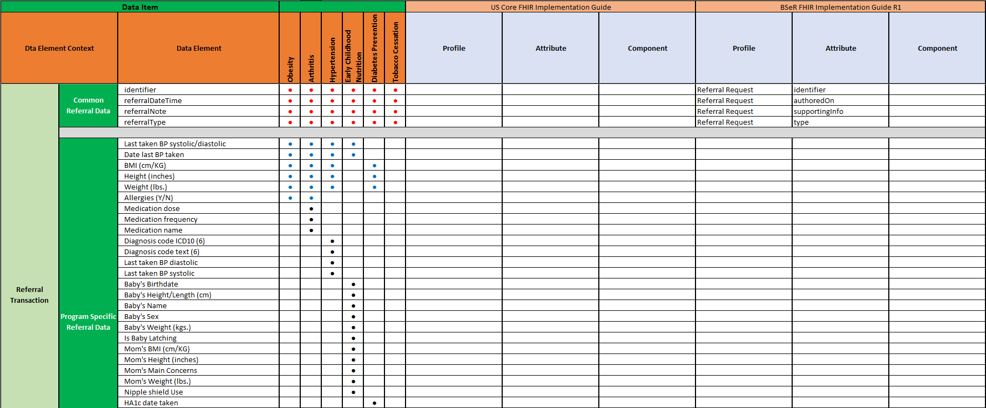
Referral Common and Program Specific Data

Slide 10
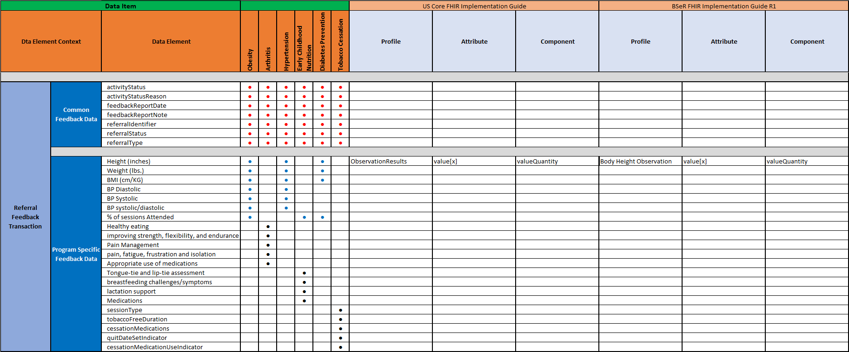
Feedback Common and Program Specific Data

Slide 11
BSeR DAM Information Model

Slide 12
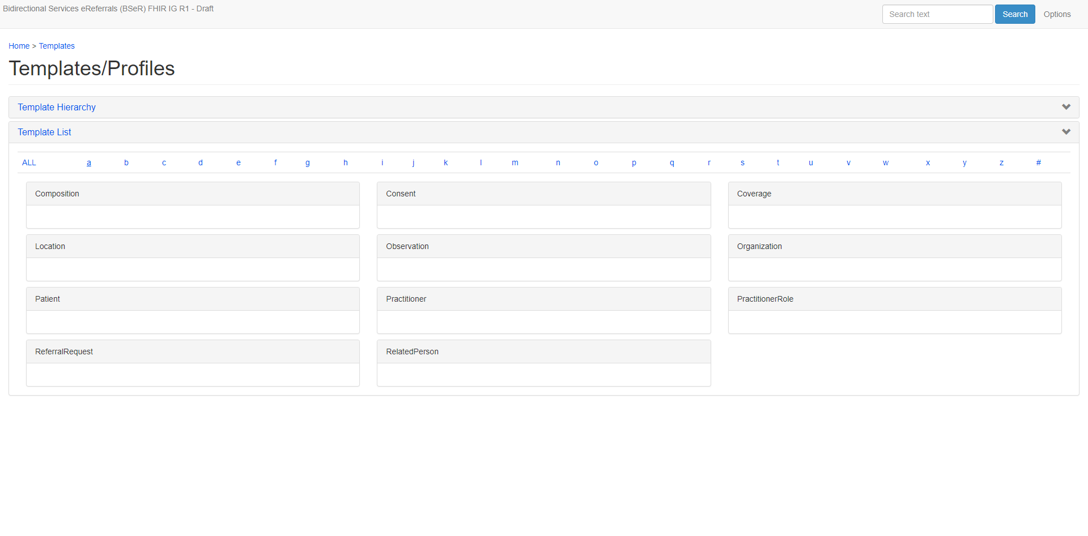
Base FHIR Resources

Slide 13
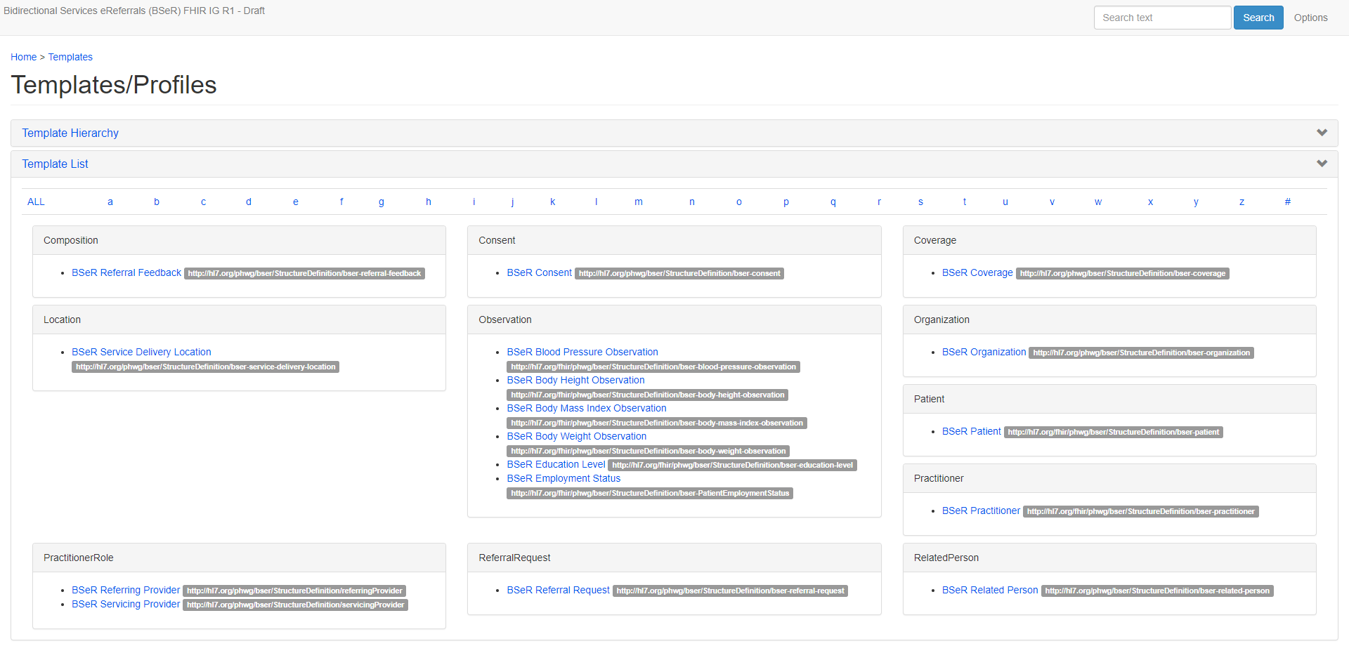
BSeR Specific FHIR Resource Profiles

Slide 14
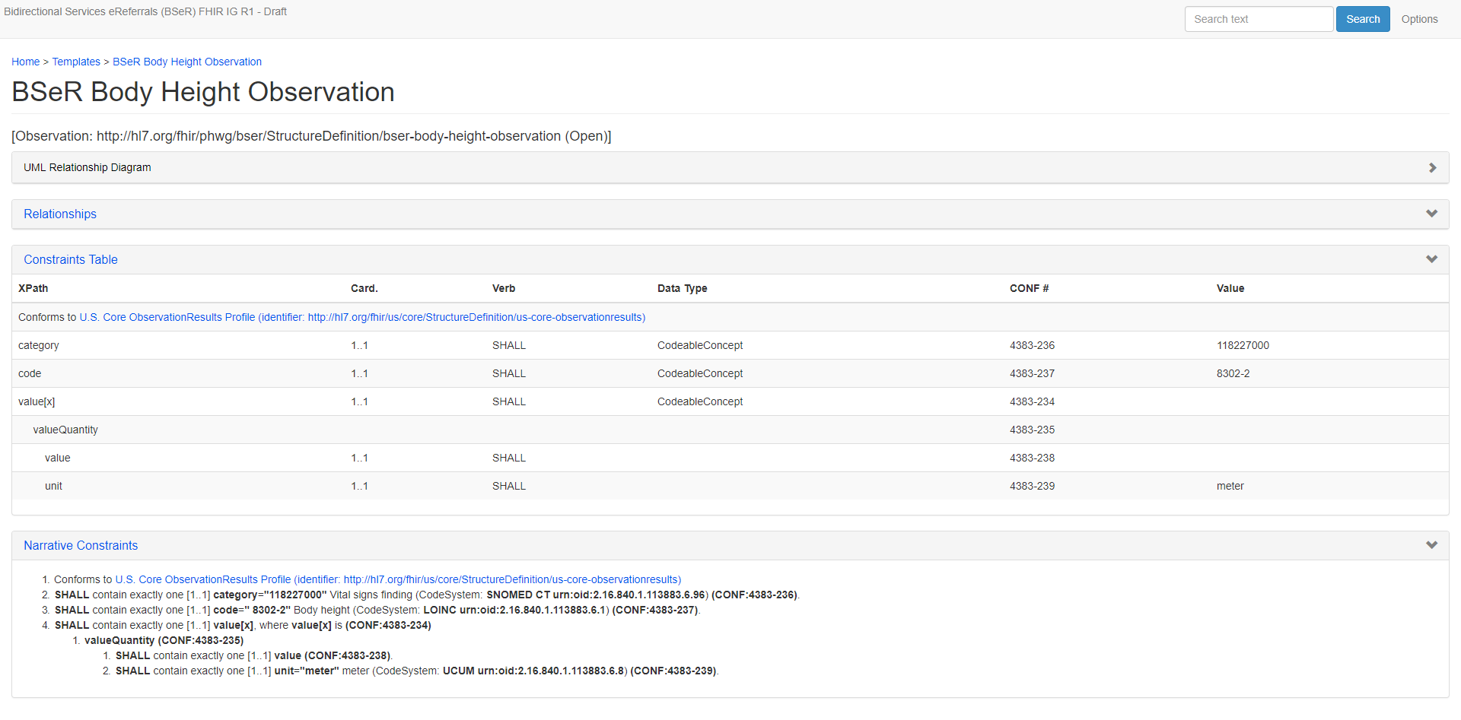
US Core FHIR Resource Profiles Reuse

Slide 15
Immediate Next Steps
08/06/18
Draft Content
Prepare draft content
Submit draft content for ballot preview period.
08/17/18 Final Content
Review ballot pre-view with PHWG
Prepare final content for ballot
09/29/18
WGM
Solicit ballot review and collect comments
Prepare prototype implementation

Slide 16


